Slide 1
Learning Fashion Compatibility with Bidirectional LSTMs
MM2017

Slide 2
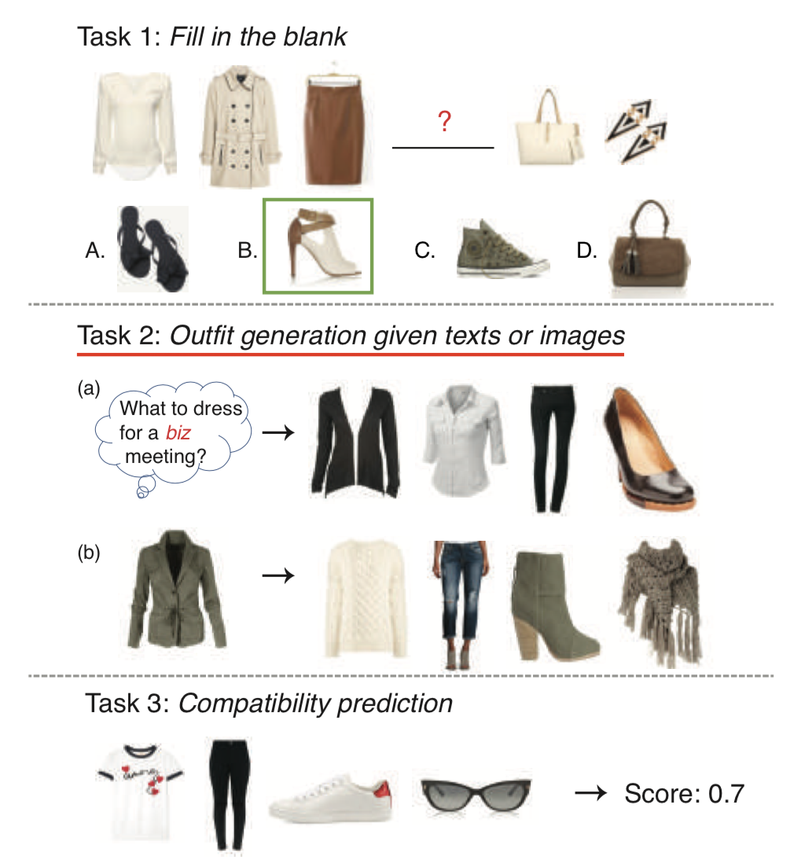
Motivation
为现存的一组items，搭配一个item
根据用户的多模态（images/text）指定生成一套outfit（现存方法不支持多模态输入）

Slide 3
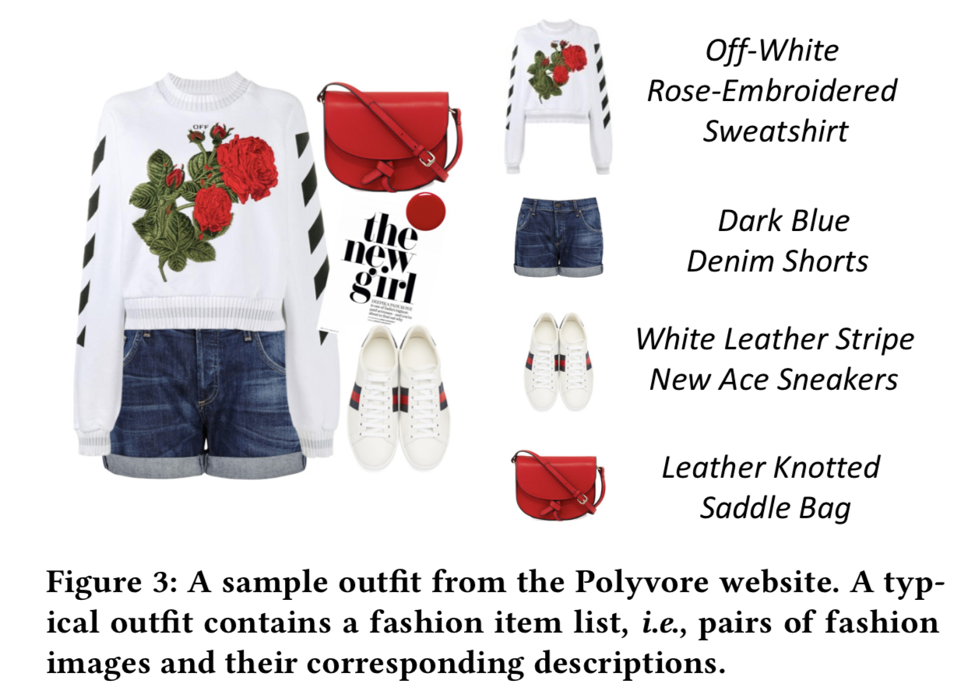
搭配的outfit应该有两个关键性质：
Items视觉上搭配，相同的style
完整的一套，没有冗余（有衬衫、牛仔裤没有鞋子是不搭配的、包含两个鞋子不搭配）

Slide 4
POLYVORE Dataset
21889 outfits ：17,316 for training, 1,497 for validation and 3,076 for testing
保留前8个items，平均items6.5个
164379items（image和text description）
文本描述：移除少于出现30次的单词，词汇表大小2757
Items被组织为固定的顺序：tops, bottoms, shoes, and the accessories.
上衣：shirts and t-shirts come before outwears
配饰：handbags, hats, glasses, watches, necklaces, earrings, etc.

Slide 5
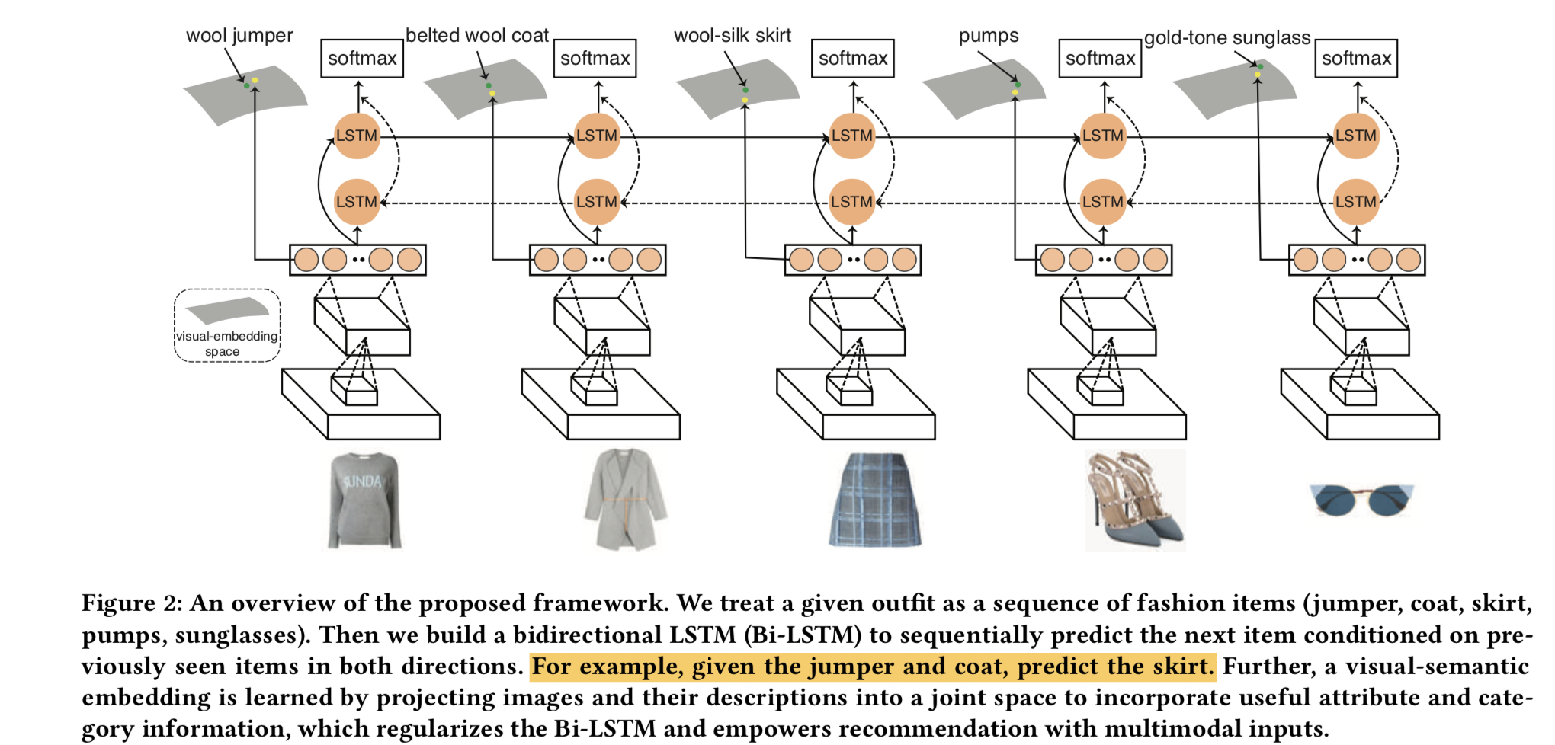
APPROACH—Fashion Compatibility Learning with Bi-LSTM

Slide 6
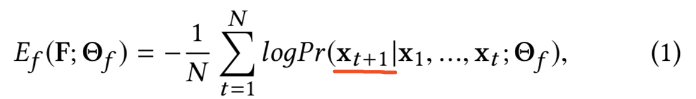
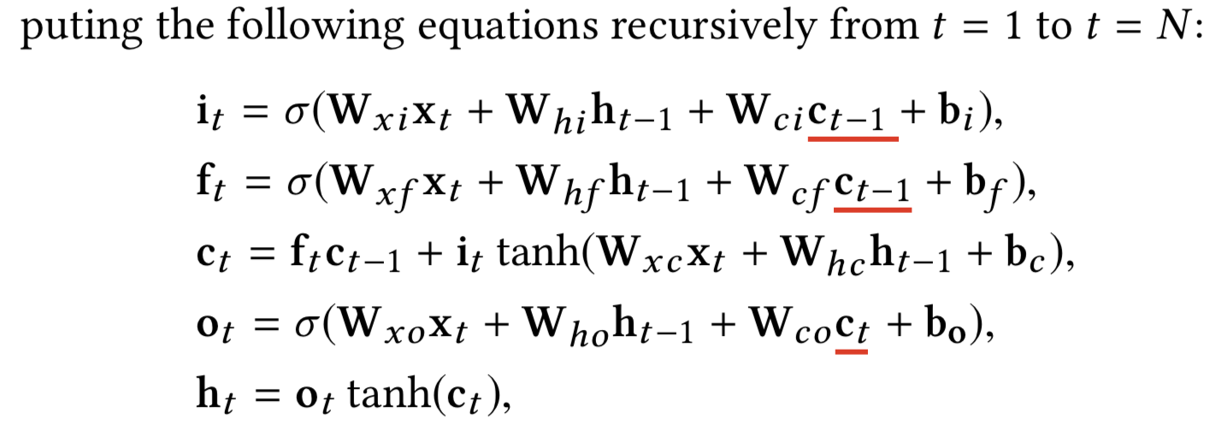
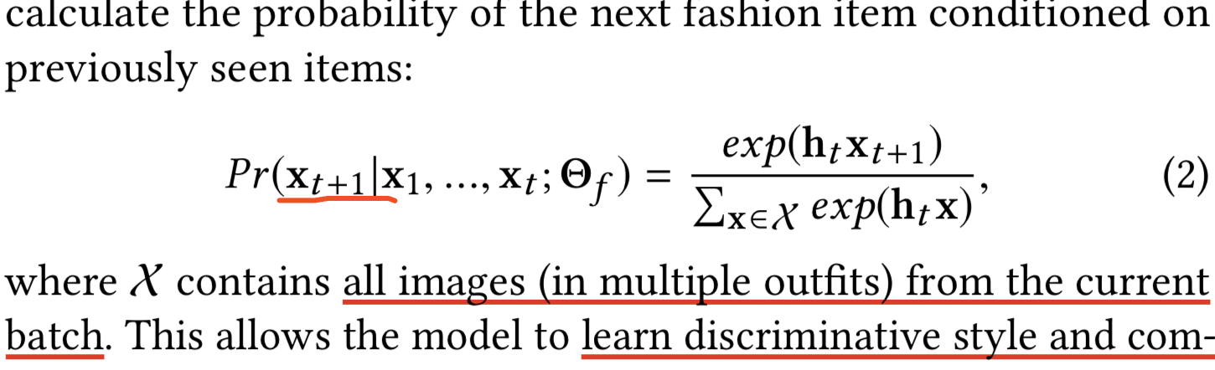
APPROACH—Fashion Compatibility Learning with Bi-LSTM
基于原有图片预测下一个图片

Slide 7
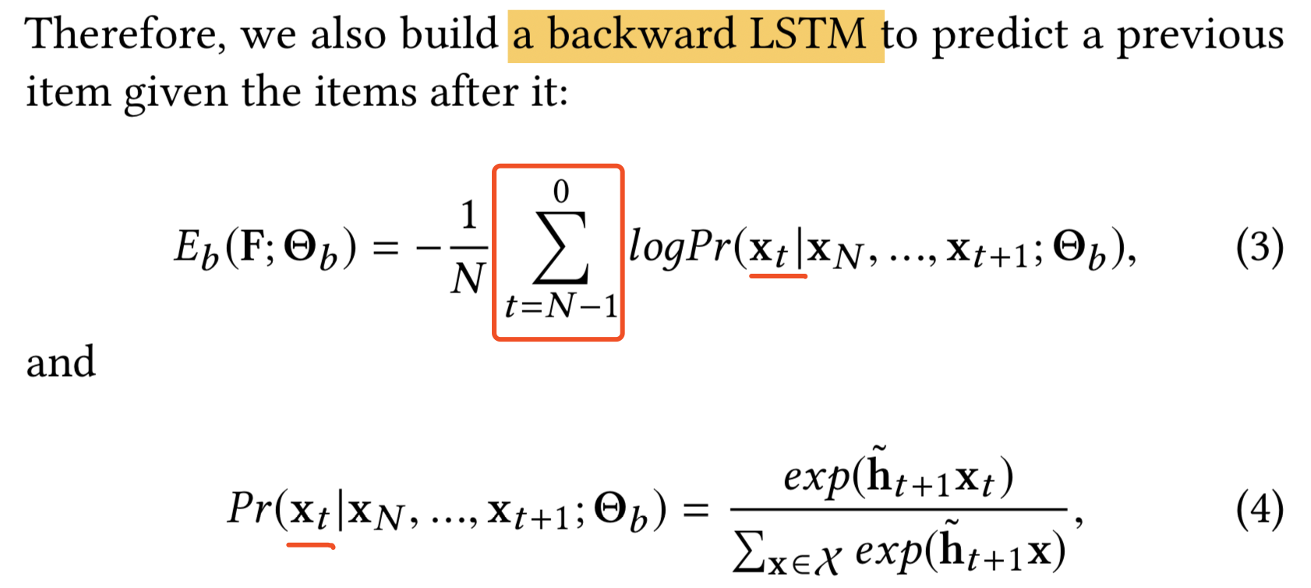
APPROACH—Fashion Compatibility Learning with Bi-LSTM
双向LSTM：学习搭配关系和outfit的整体风格

Slide 8
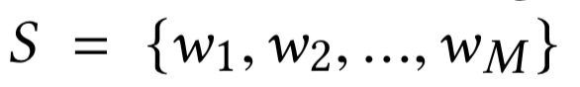
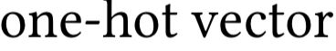
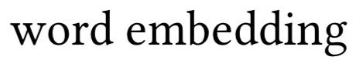
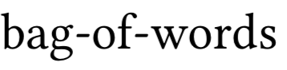
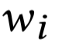
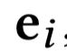
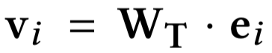
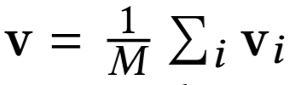
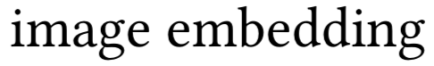
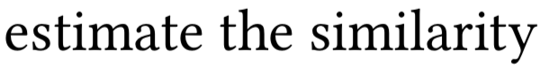
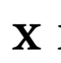
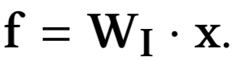
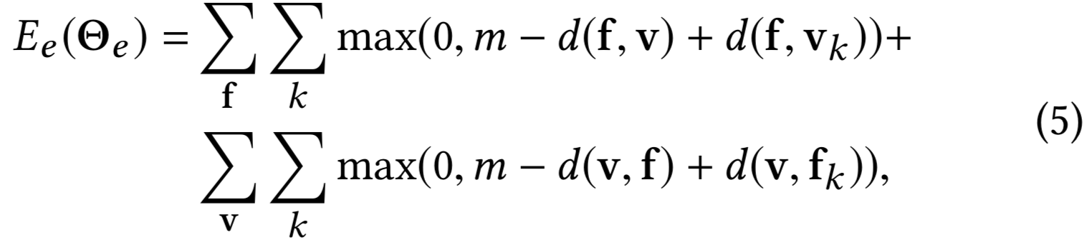
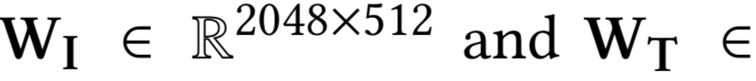
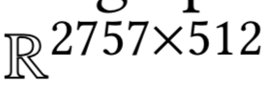
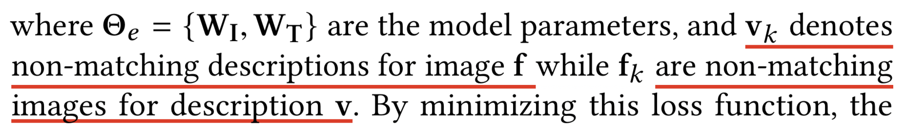
APPROACH—Visual-semantic Embedding 提供类别和属性信息
wi represents each word in the description.
Notes:
minimizing the following contrastive loss:

Slide 9
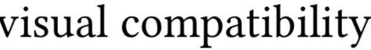
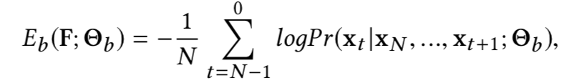
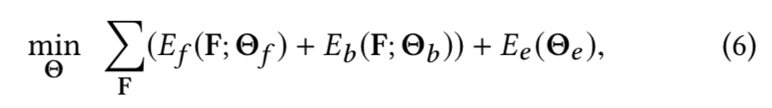
APPROACH—Joint Modeling
Semantic information
Notes:
The only difference compared to a standard Bi-LSTM model during back- propagation is that the gradients of the CNN model now stem from the average of two sources (See Figure 2), allowing the CNN model to learn useful semantic information at the same time.

Slide 10
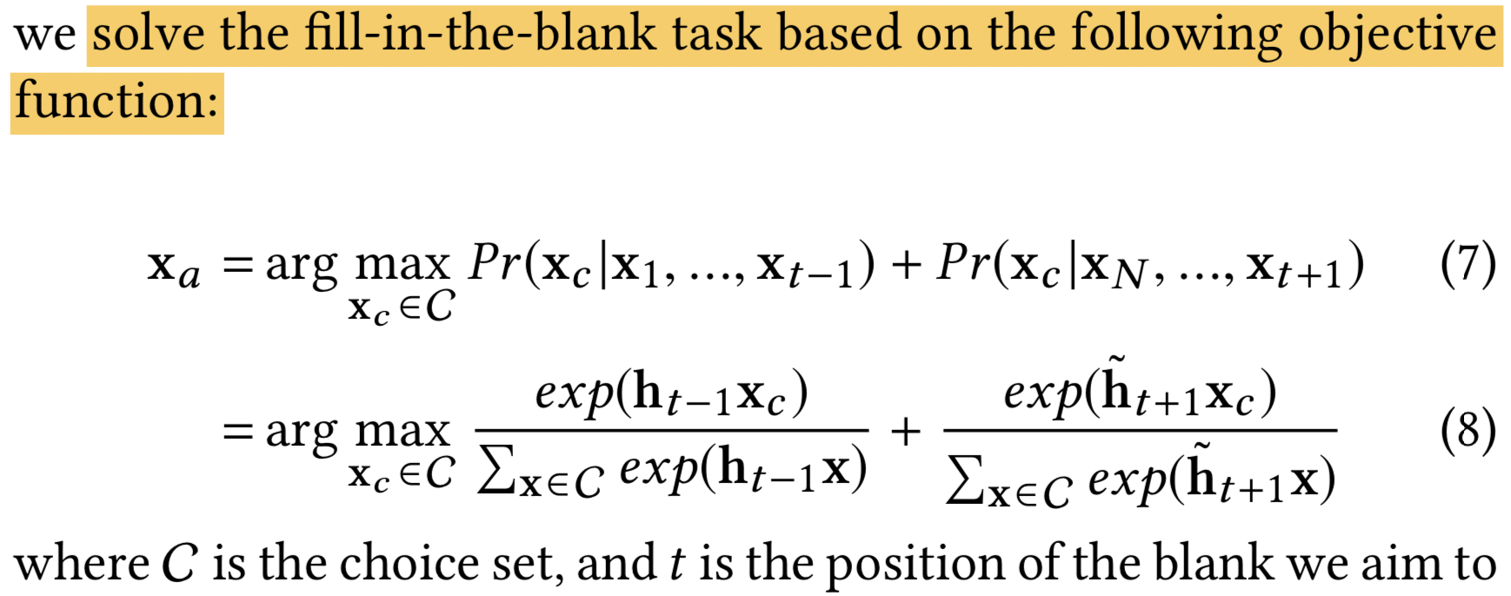
EXPERIMENT—Fill-in-the-blank Fashion Recommendation

Slide 11
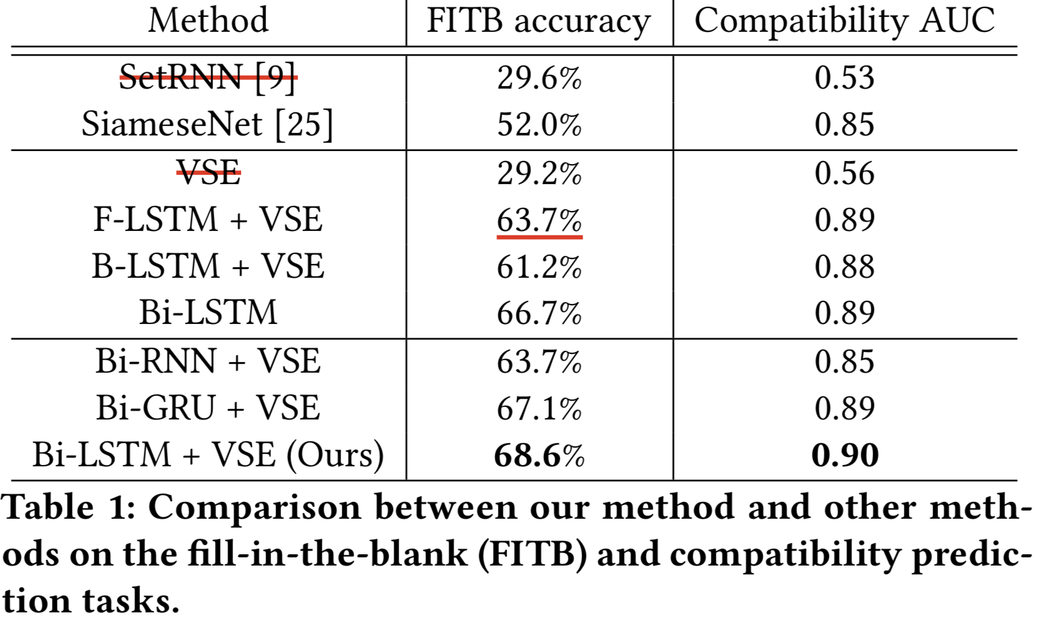
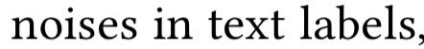
EXPERIMENT—Fill-in-the-blank Fashion Recommendation

Slide 12
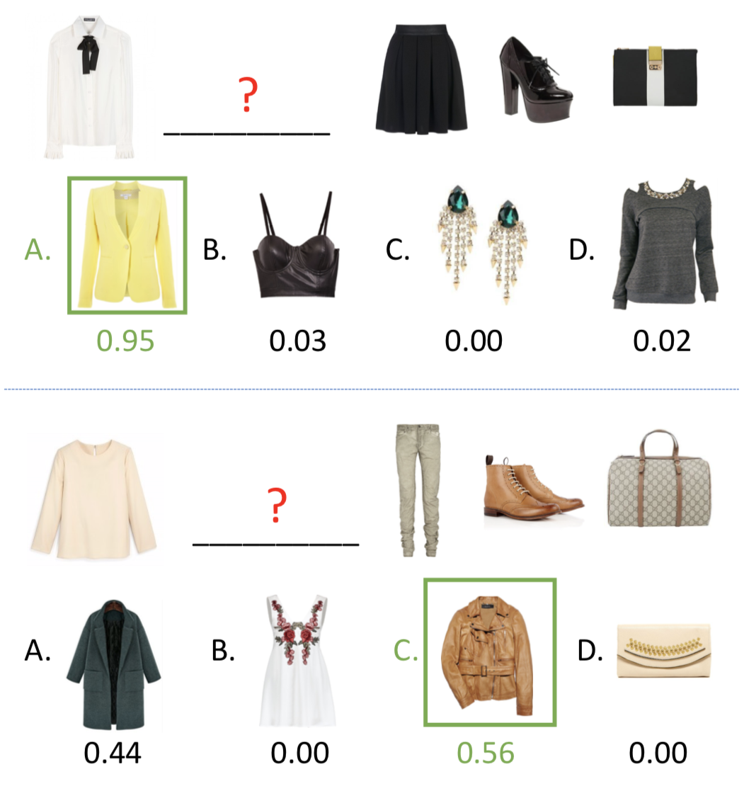
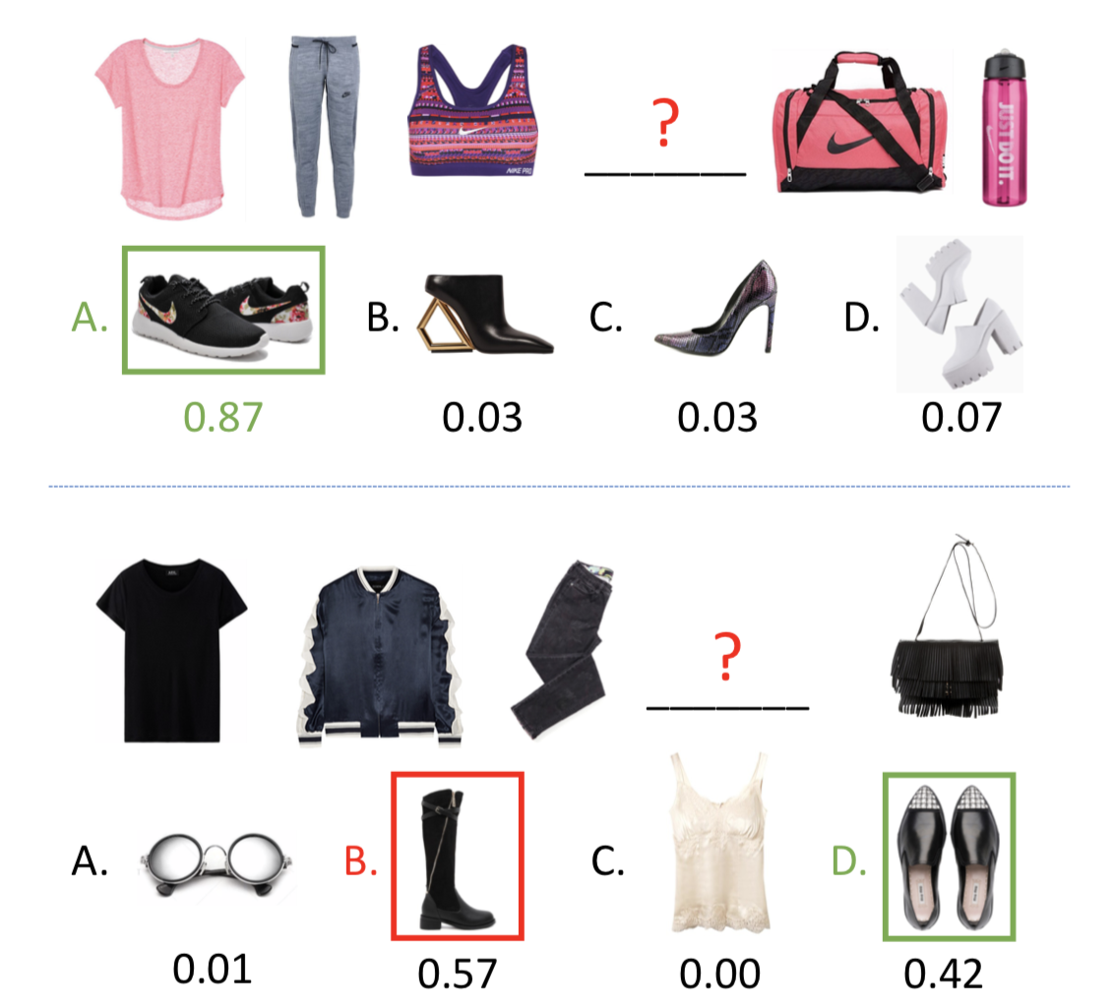
EXPERIMENT—Fill-in-the-blank Fashion Recommendation
detect what kinds of
matches their style

Slide 13
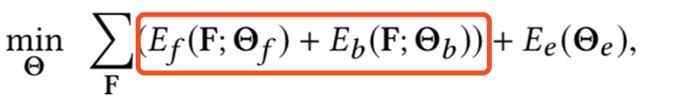
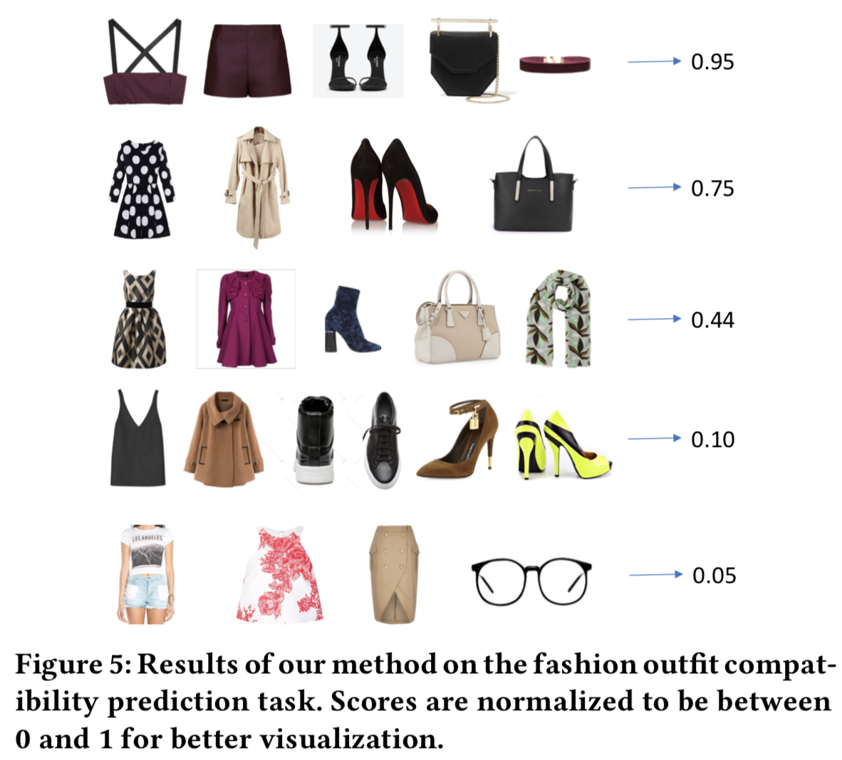
EXPERIMENT—Fashion Compatibility Prediction

Slide 14
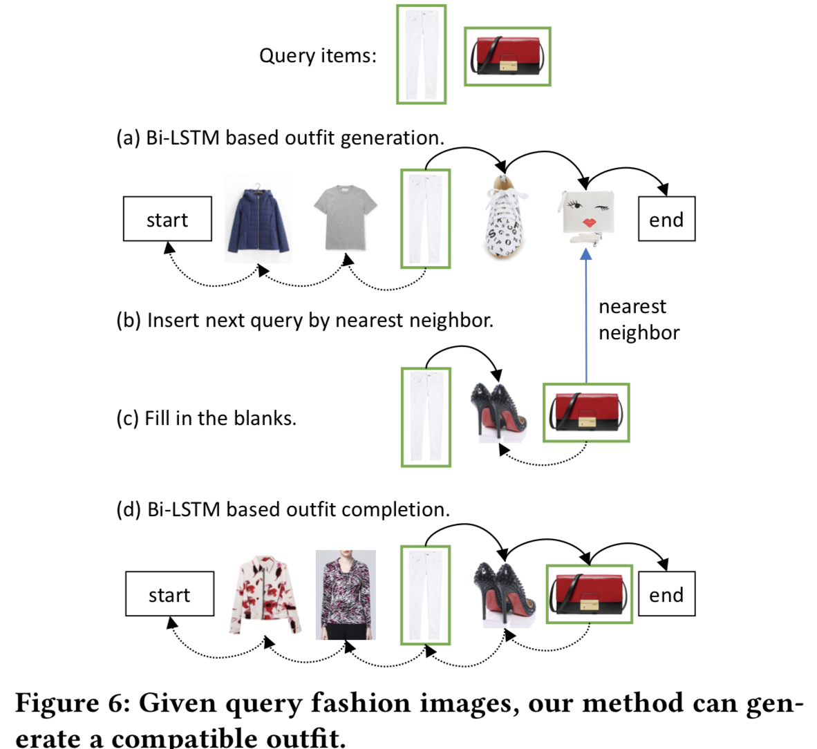
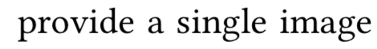
EXPERIMENT—Fashion Outfit Generation——from query image
利用第一个item生成初始outfit
找到并替换下一个query item的最近邻居（b)
如果两个item相邻，双向推理生成outfit
否则，在两个items之间填完所有的空(c),确保用于生成整个outfit的子序列视觉上搭配
基于子序列，双向LSTM生成outfit(d)

Slide 15
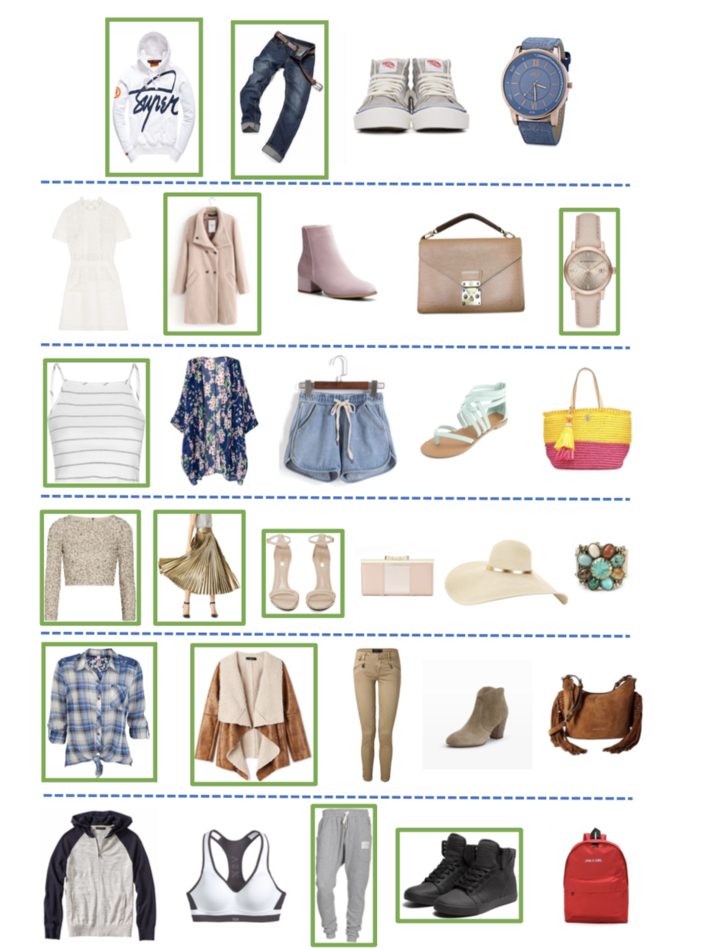
EXPERIMENT—Fashion Outfit Generation——from query image

Slide 16
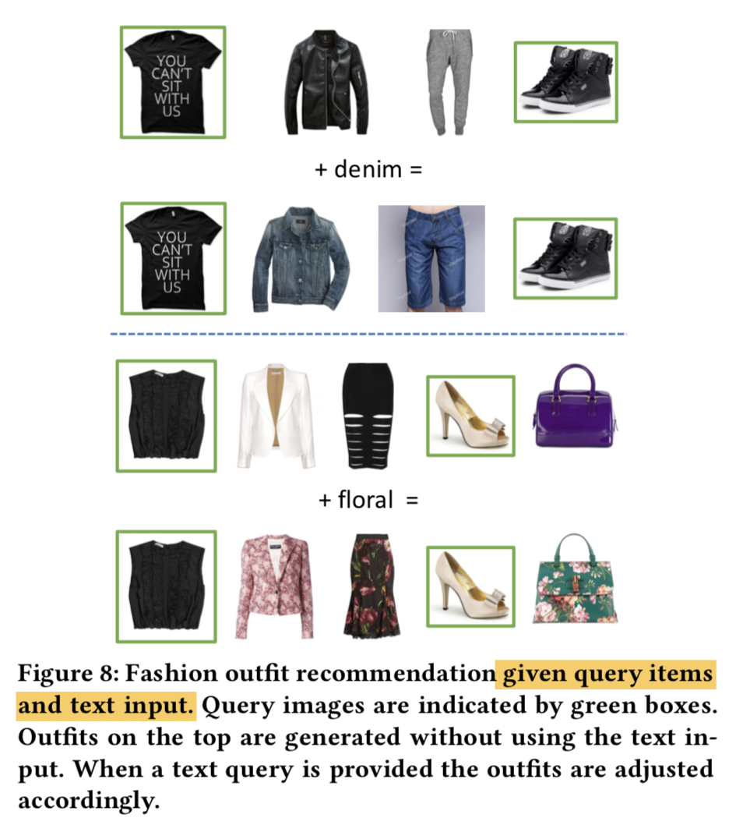
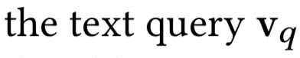
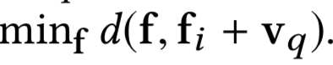
EXPERIMENT—Fashion Outfit Generation——from Multimodal Queries
视觉上搭配，和给定text语义上相关
初始outfit的每一个non-query item fi 被更新
因此，更新的item既和原始的items相似也和text在视觉-语义嵌入空间是接近的

Slide 17
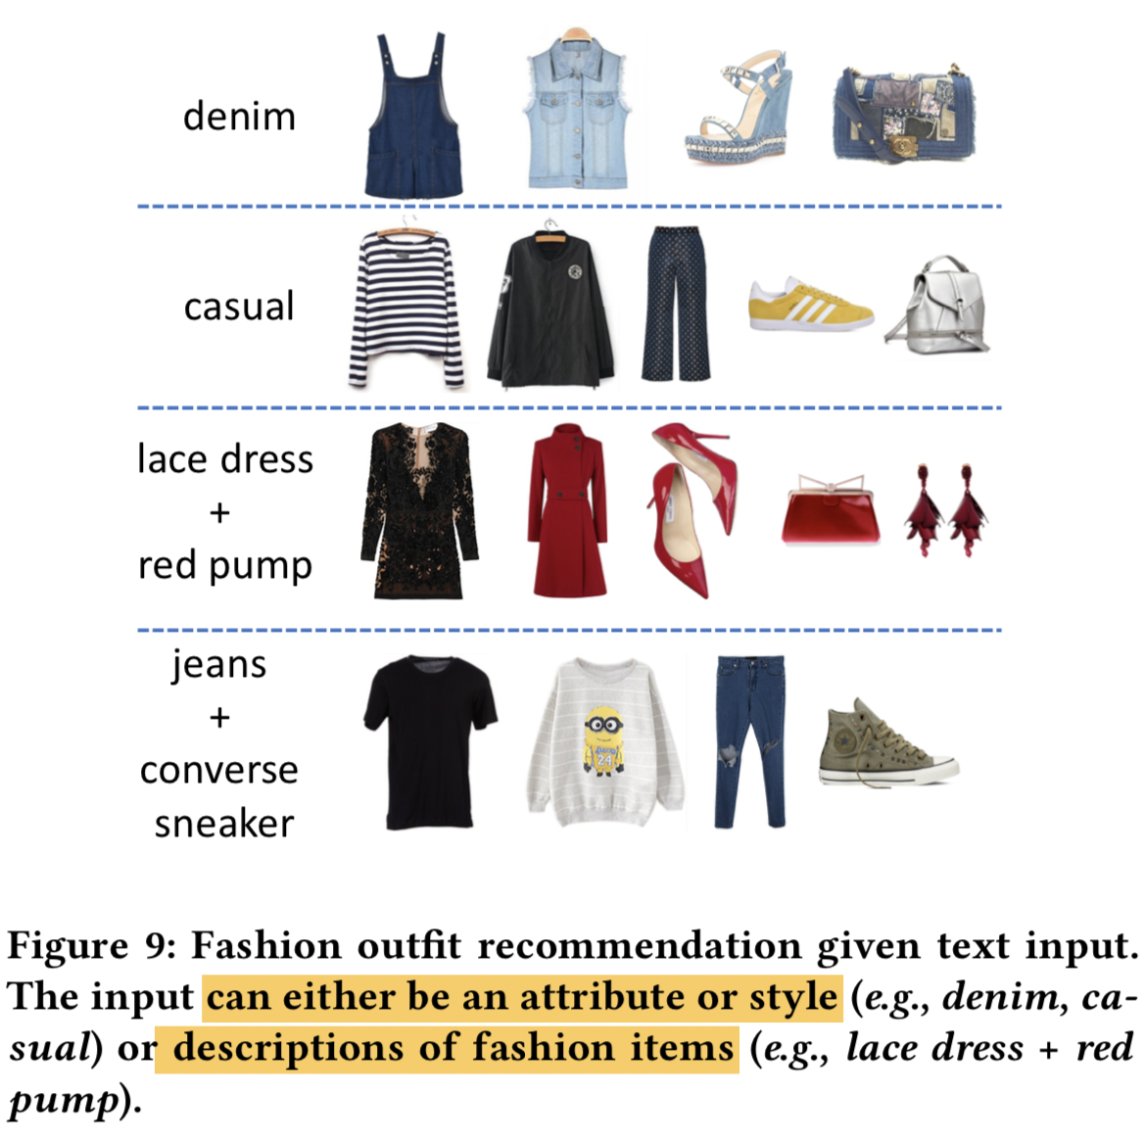
EXPERIMENT—Fashion Outfit Generation ——from text query
和text query最近的image被选做为query image；使用双向LSTM；更新类似混合输入。
使用每个描述检索item图像，并将所有图像视为query images生成outfit。

